Slide 1

Predicting Factors that Influence Buying Behaviour
By Ahmad Ari Aldino

Slide 2
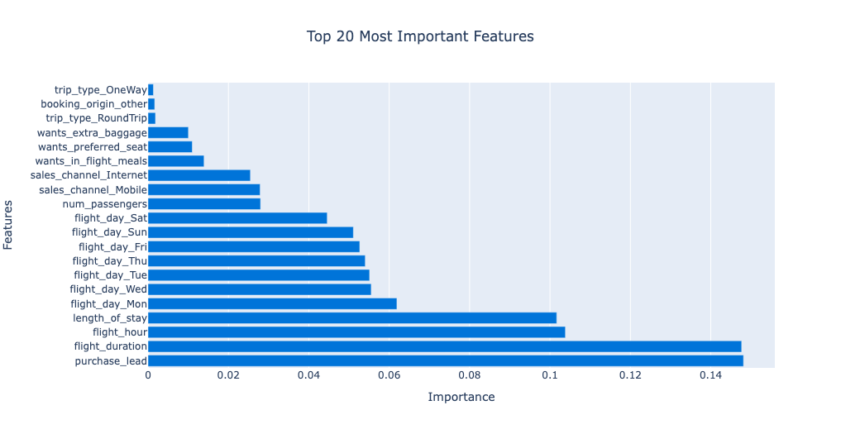
Random Forest
Model Performance
on Testing Set:
Accuracy: 0.90
Precision: 0.95
Recall: 0.84
F1 Score: 0.89
ROC AUC: 0.90
using Cross-Validation:
Accuracy: 0.90
Precision: 0.96
Recall: 0.84
F1 Score: 0.89
ROC AUC: 0.95
Model Performance: The Random Forest model showcases robust performance with high accuracy (90% on testing set and cross-validation) and precise predictions (0.95/0.96 precision). It effectively distinguishes between classes, as indicated by an ROC AUC of 0.90 on the testing set and 0.95 through cross-validation.
Feature Importance: In terms of feature importance, the analysis reveals that several factors play a crucial role in predicting the target variable. The time between purchase and the flight date, as well as the duration of the flight, are identified as the most influential features. Additionally, the specific flight hour, length of stay, and the day of the week on which the flight occurs also contribute significantly to the model's decision-making process. Other features such as the number of passengers, sales channel, and customer preferences for in-flight meals exhibit relatively lower but still noticeable importance.
Recommendations:
Targeted Marketing: Utilize the influential features, such as the time between purchase and the flight date, flight duration, and specific flight hours, to tailor marketing strategies. For example, customers who book well in advance may respond differently to promotional offers compared to those who book closer to the flight date. Similarly, customers with longer flight durations may have distinct preferences or requirements that can be addressed through personalized marketing campaigns.
Pricing Strategies: Consider incorporating the length of stay and the day of the week on which the flight occurs into pricing strategies. Adjusting prices based on these factors can optimize revenue by reflecting variations in demand patterns. For instance, offering discounted fares for mid-week flights or longer stays might attract more customers during less busy periods.
Customer Experience Enhancement: Leverage the insights gained from features like the number of passengers, sales channels, and in-flight preferences to enhance the overall customer experience. For example, understanding customers' preferences for in-flight meals, preferred seats, or extra baggage can help tailor service offerings and improve customer satisfaction.

